Slide 1
COMP30027 MACHINE LEARNING
TUTORIAL
Workshop - 1

Slide 2

Real-World Applications of Machine Learning

Slide 3

Voice Assistants

Slide 4

Movie Recommendation System

Slide 5
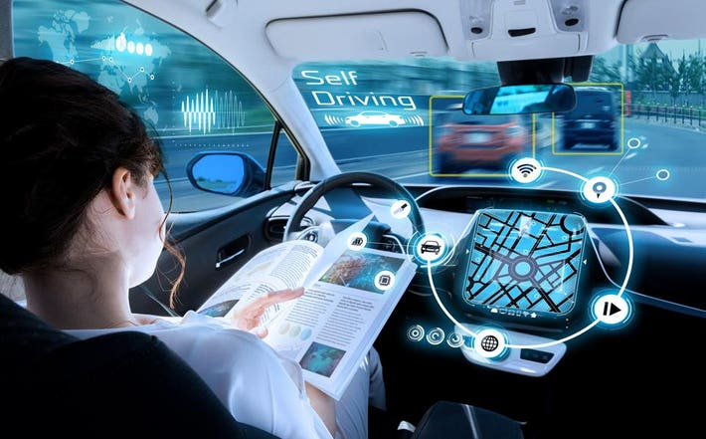
Self-Driving Cars

Slide 6
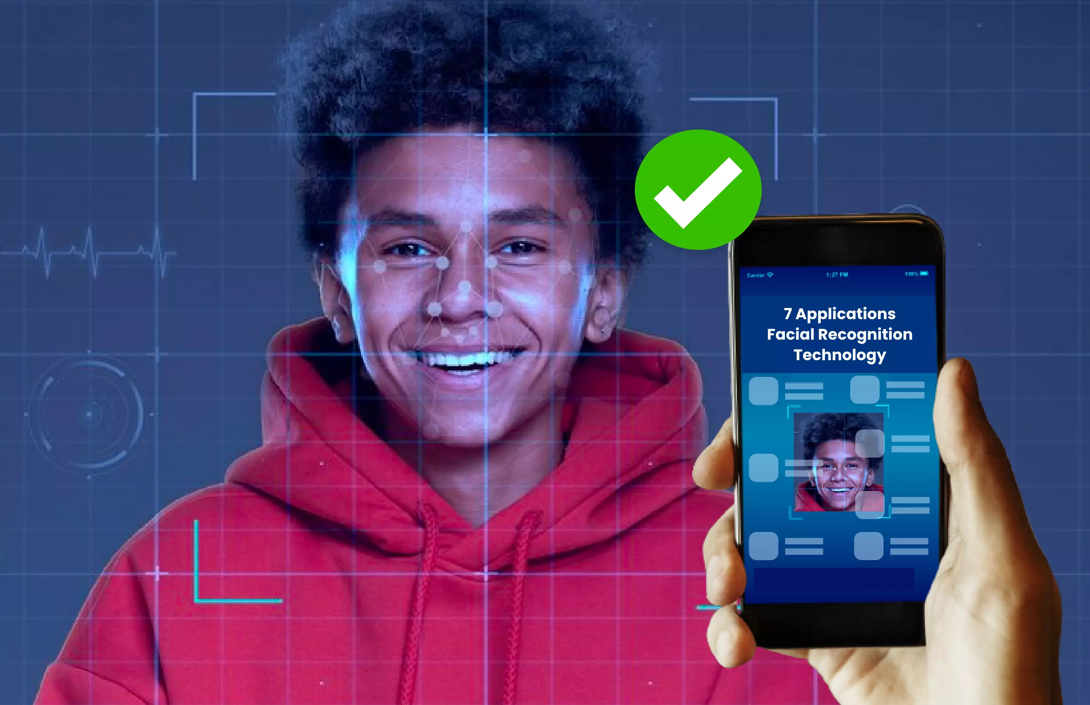
Facial Recognition System
https://www.lystloc.com/blog/7-applications-of-facial-recognition-technology/

Slide 7
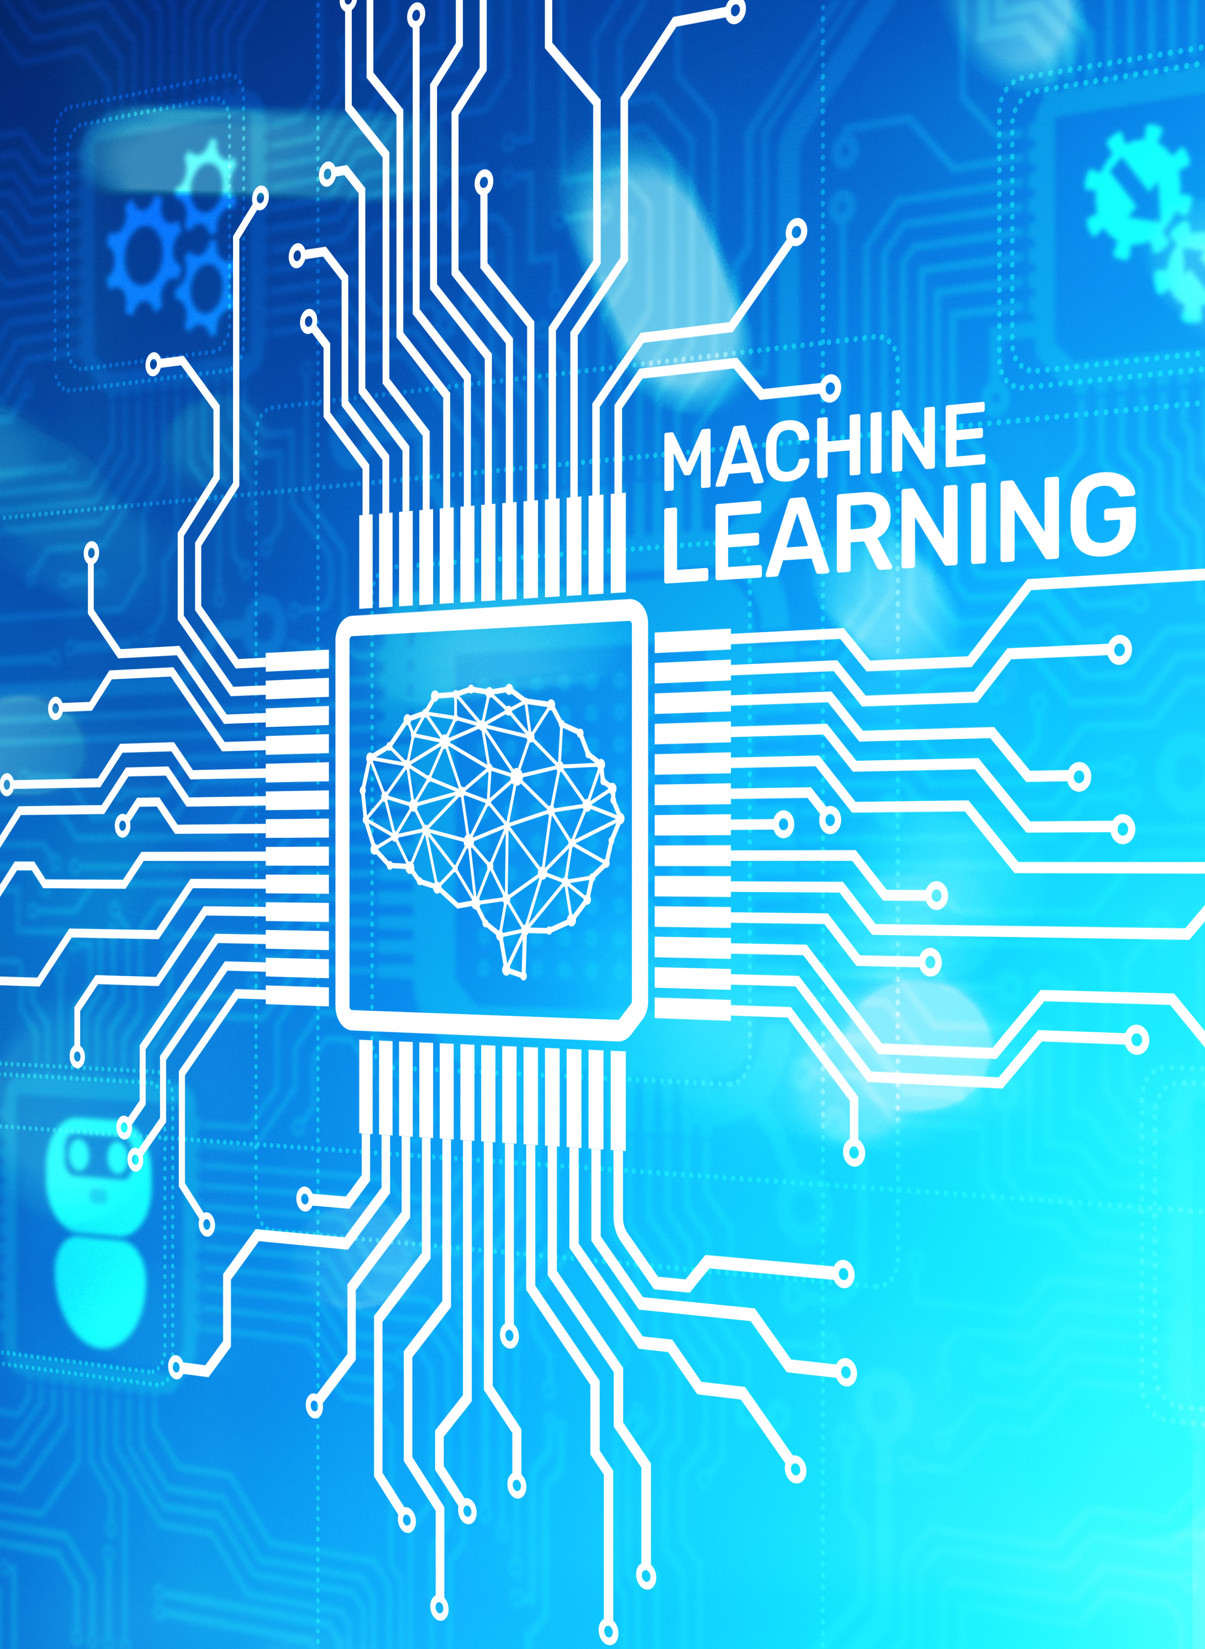
Machine Learning
Automatic extraction of valid, novel, useful, and comprehensible knowledge (rules, regularities, patterns, constraints, models, …) from arbitrary sets of data
“Field of study that gives computers the ability to learn without being explicitly programmed” –Arthur Samuel

Slide 8
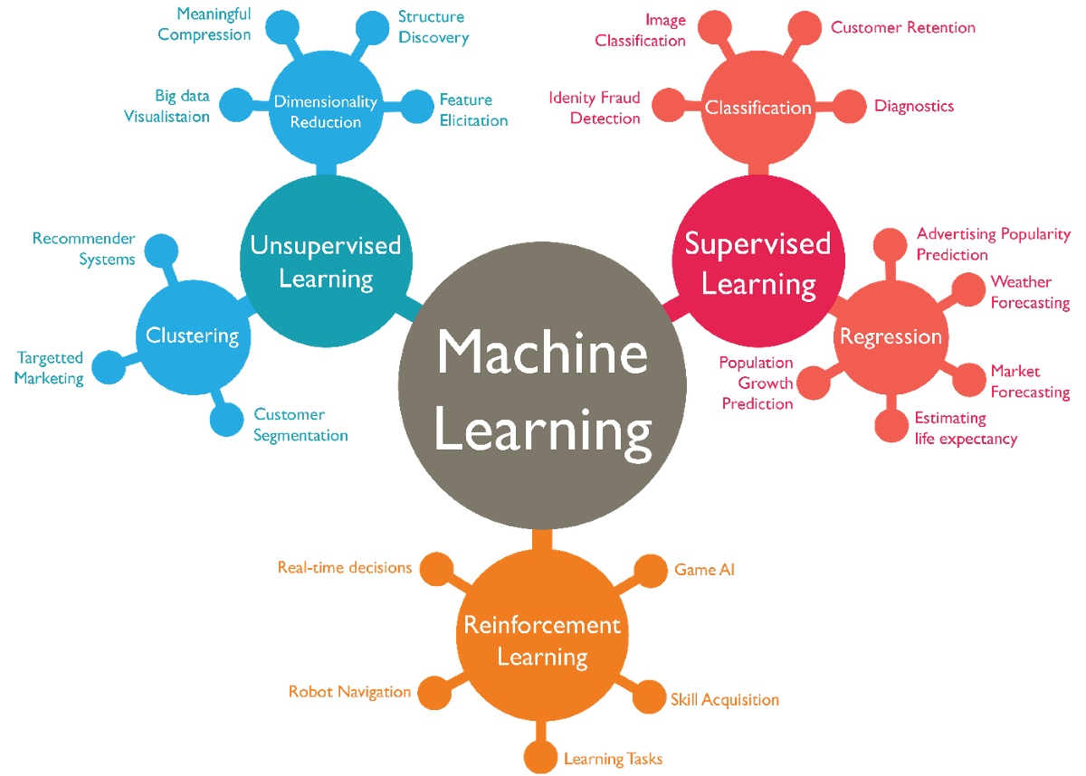
Types of Machine Learning
Supervised Learning
Algorithms trained on labeled data, learning to map inputs to known outputs.
Unsupervised Learning
Discovers hidden patterns in unlabeled data without human guidance.
Semi-Supervised Learning
Leverages both labeled and unlabeled data to improve learning efficiency.
Reinforcement Learning
Learns optimal actions through trial and error with a reward system.

Slide 9
Types of Machine Learning
Supervised Learning
Algorithms trained on labeled data, learning to map inputs to known outputs.
Unsupervised Learning
Discovers hidden patterns in unlabeled data without human guidance.
Semi-Supervised Learning
Leverages both labeled and unlabeled data to improve learning efficiency.
Reinforcement Learning
Learns optimal actions through trial and error with a reward system.

Slide 10
Types of Machine Learning
Supervised Learning
Algorithms trained on labeled data, learning to map inputs to known outputs.
Unsupervised Learning
Discovers hidden patterns in unlabeled data without human guidance.
Semi-Supervised Learning
Leverages both labeled and unlabeled data to improve learning efficiency.
Reinforcement Learning
Learns optimal actions through trial and error with a reward system.

Slide 11
Types of Machine Learning
Supervised Learning
Algorithms trained on labeled data, learning to map inputs to known outputs.
Unsupervised Learning
Discovers hidden patterns in unlabeled data without human guidance.
Semi-Supervised Learning
Leverages both labeled and unlabeled data to improve learning efficiency.
Reinforcement Learning
Learns optimal actions through trial and error with a reward system.

Slide 12
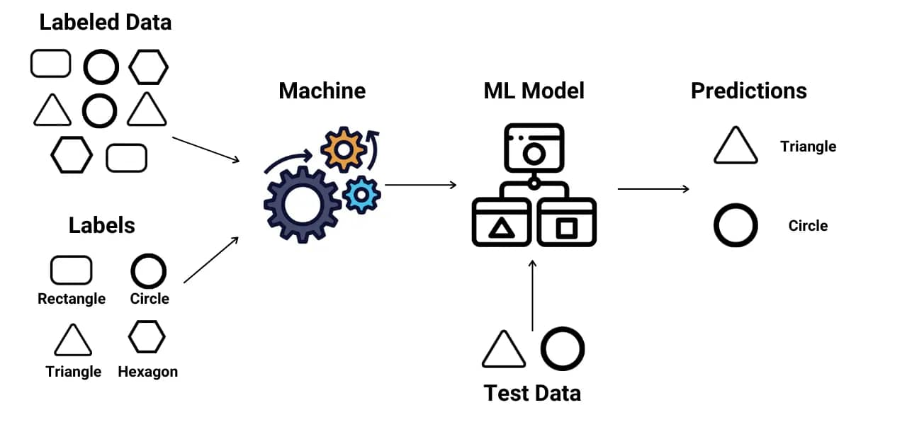
Supervised Learning Algorithms
https://www.pipedrive.com/en/blog/types-of-machine-learning

Slide 13
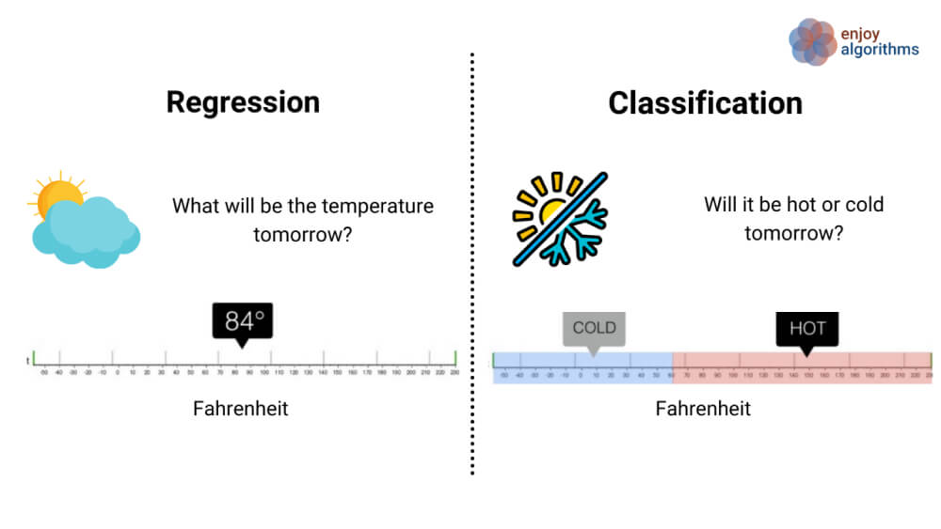
Supervised Learning Algorithms
Classification
Regression
Categorizes data into predefined classes.
Predicts continuous numerical values.
https://www.superannotate.com/blog/supervised-learning-and-other-machine-learning-tasks
Notes:
Decision Trees break down decisions step-by-step. Support Vector Machines find optimal boundaries. Neural Networks mimic brain structures. Examples include email spam filtering and disease diagnosis. Used for house price estimation and stock forecasting

Slide 14
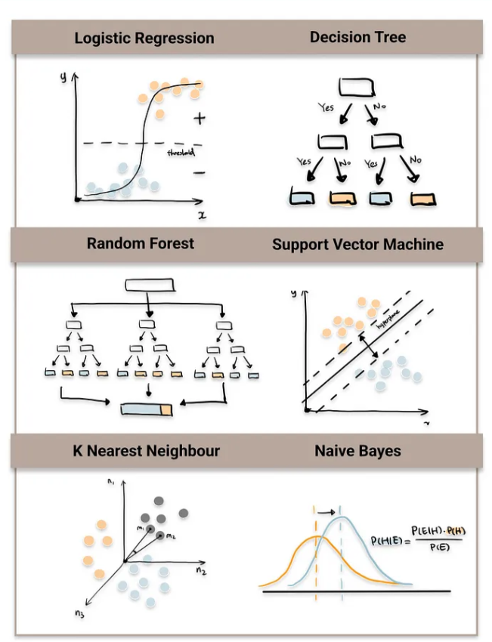
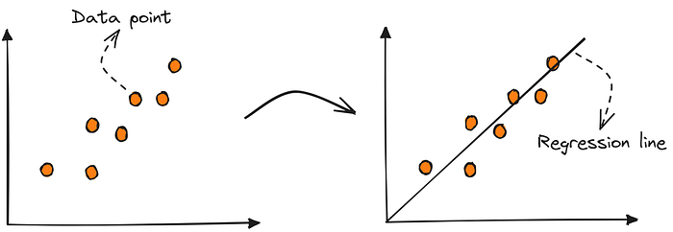
Supervised Learning Algorithms
Classification
Regression
Linear Regression
https://pub.towardsai.net/machine-learning-the-first-step-is-to-understand-simple-linear-regression-30dde8b4739
https://towardsdatascience.com/top-machine-learning-algorithms-for-classification-2197870ff501/
Notes:
Decision Trees break down decisions step-by-step. Support Vector Machines find optimal boundaries. Neural Networks mimic brain structures. Examples include email spam filtering and disease diagnosis. Used for house price estimation and stock forecasting

Slide 15

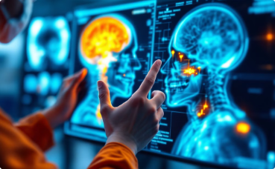
Real-World Applications of Supervised Learning
Email Spam Filtering
Medical Diagnostics
ML algorithms analyze message content and sender patterns to identify unwanted emails.
ML helps detect diseases in medical images with remarkable accuracy.

Slide 16
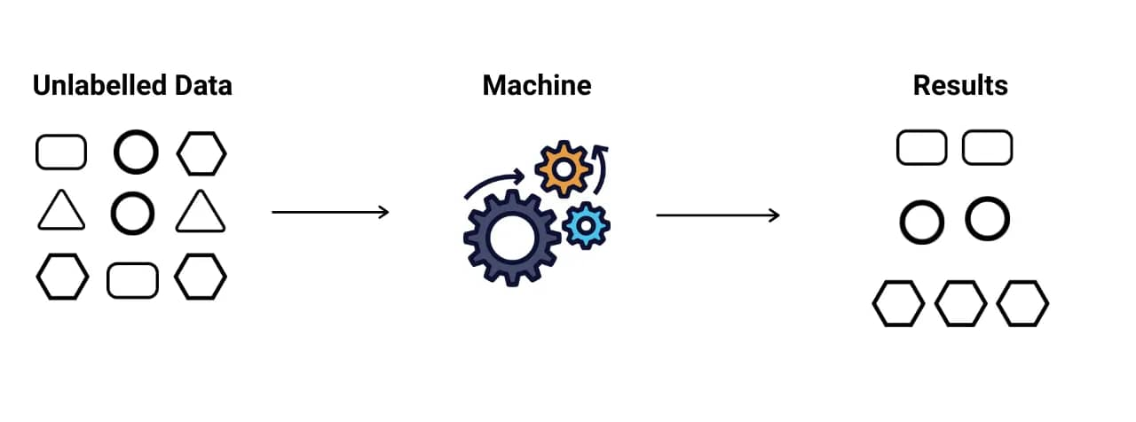
Unsupervised Learning Algorithms
https://www.pipedrive.com/en/blog/types-of-machine-learning

Slide 17
Unsupervised Learning Algorithms
Clustering
Dimensionality Reduction
Anomaly Detection
Groups similar data points together. K-means divides data into K clusters based on similarity. Businesses use this for customer segmentation.
Reduces the number of variables while preserving important information. Principal Component Analysis (PCA) transforms data to fewer dimensions.
Identify rare or unusual patterns in data that do not conform to expected behavior. It is commonly applied in fields like fraud detection.

Slide 18
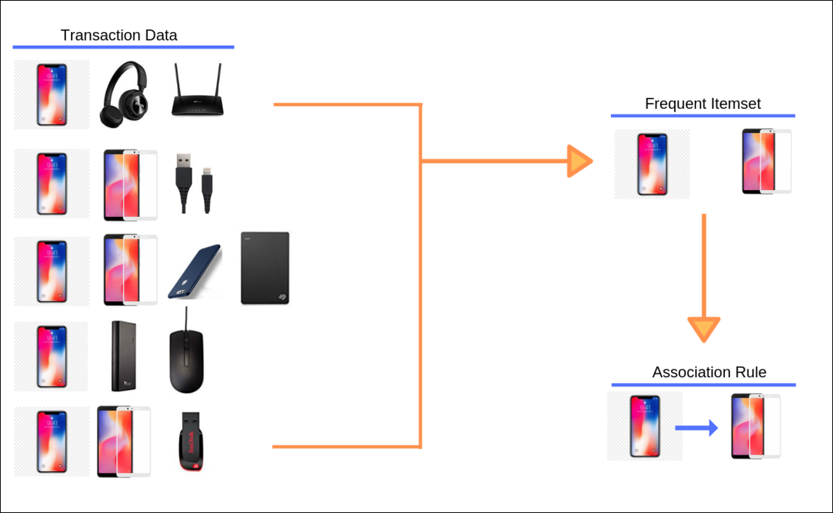
Association Rule Learning in Machine Learning
Association learning algorithms discover relationships between variables in large datasets. They identify patterns that might otherwise remain hidden.
The classic example is market basket analysis, where retailers learn that customers who buy phone often purchase screen card simultaneously.
https://www.r-bloggers.com/2019/05/practical-introduction-to-market-basket-analysis-asociation-rules-2/

Slide 19





Key Machine Learning Terminology
Instance
Attribute
Concept
Training
Testing
A single example in your dataset. Each row in a table represents one instance, like an individual customer record.
A feature or characteristic of an instance. For a house, attributes might include square footage, location, and age.
The target parameter to be learned. It defines the relationship between inputs and the desired output.
Collection of example data used to teach the model patterns and relationships.
Separate data used to evaluate model performance on unseen examples.
Nominal
Ordinal
Continuous
Variable can take multiple values which are discrete
types or categories
Variable has discrete values, and they have a natural order
Variable is real-valued with a defined zero point
and no explicit bound

Slide 20
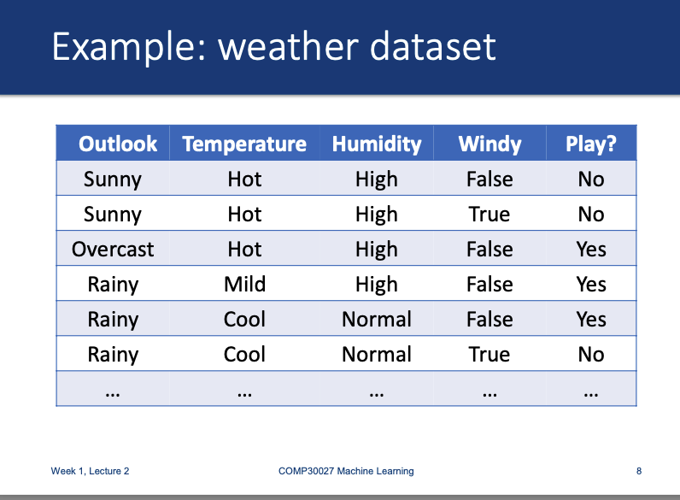

Slide 21
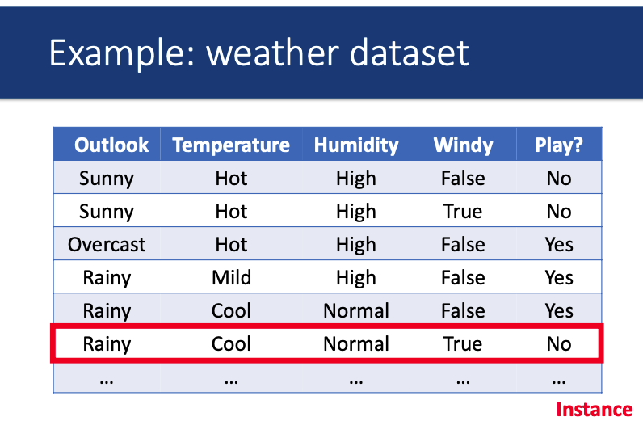

Slide 22
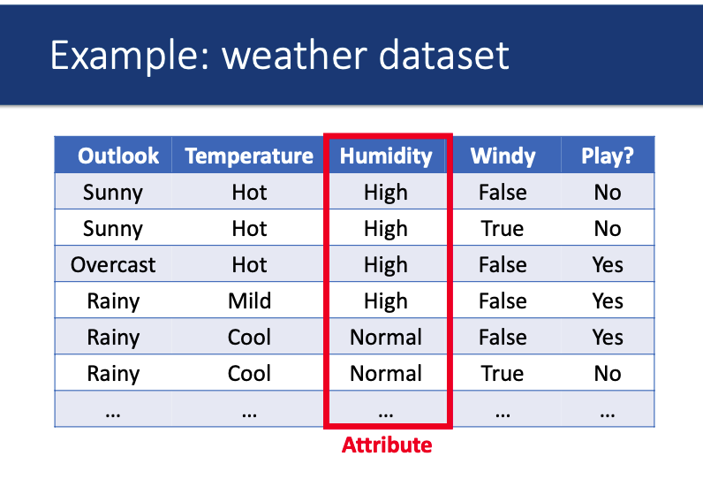

Slide 23
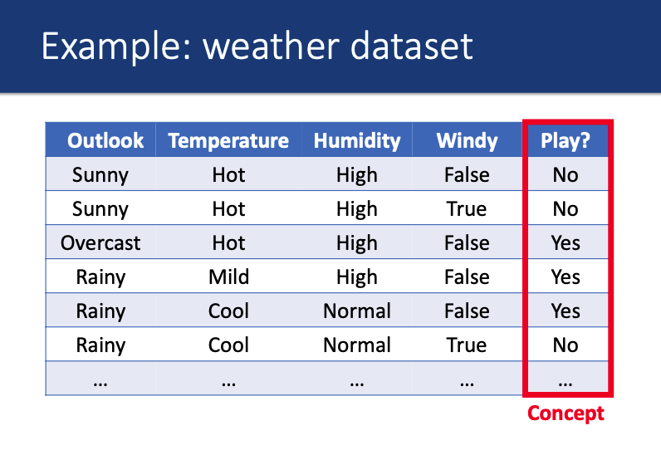

Slide 24
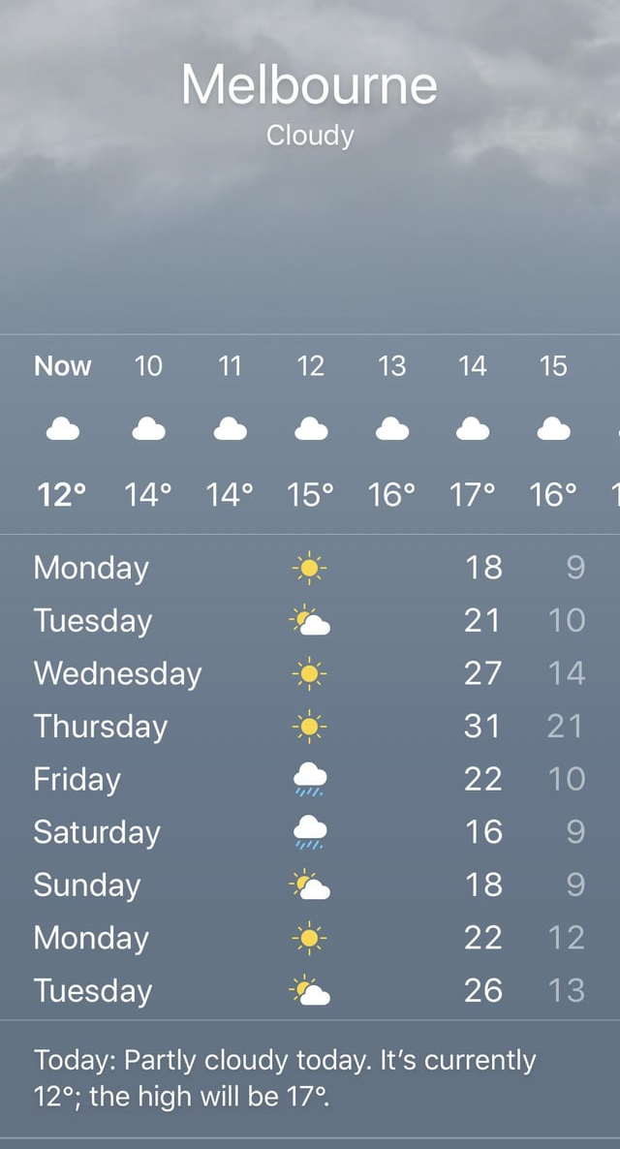

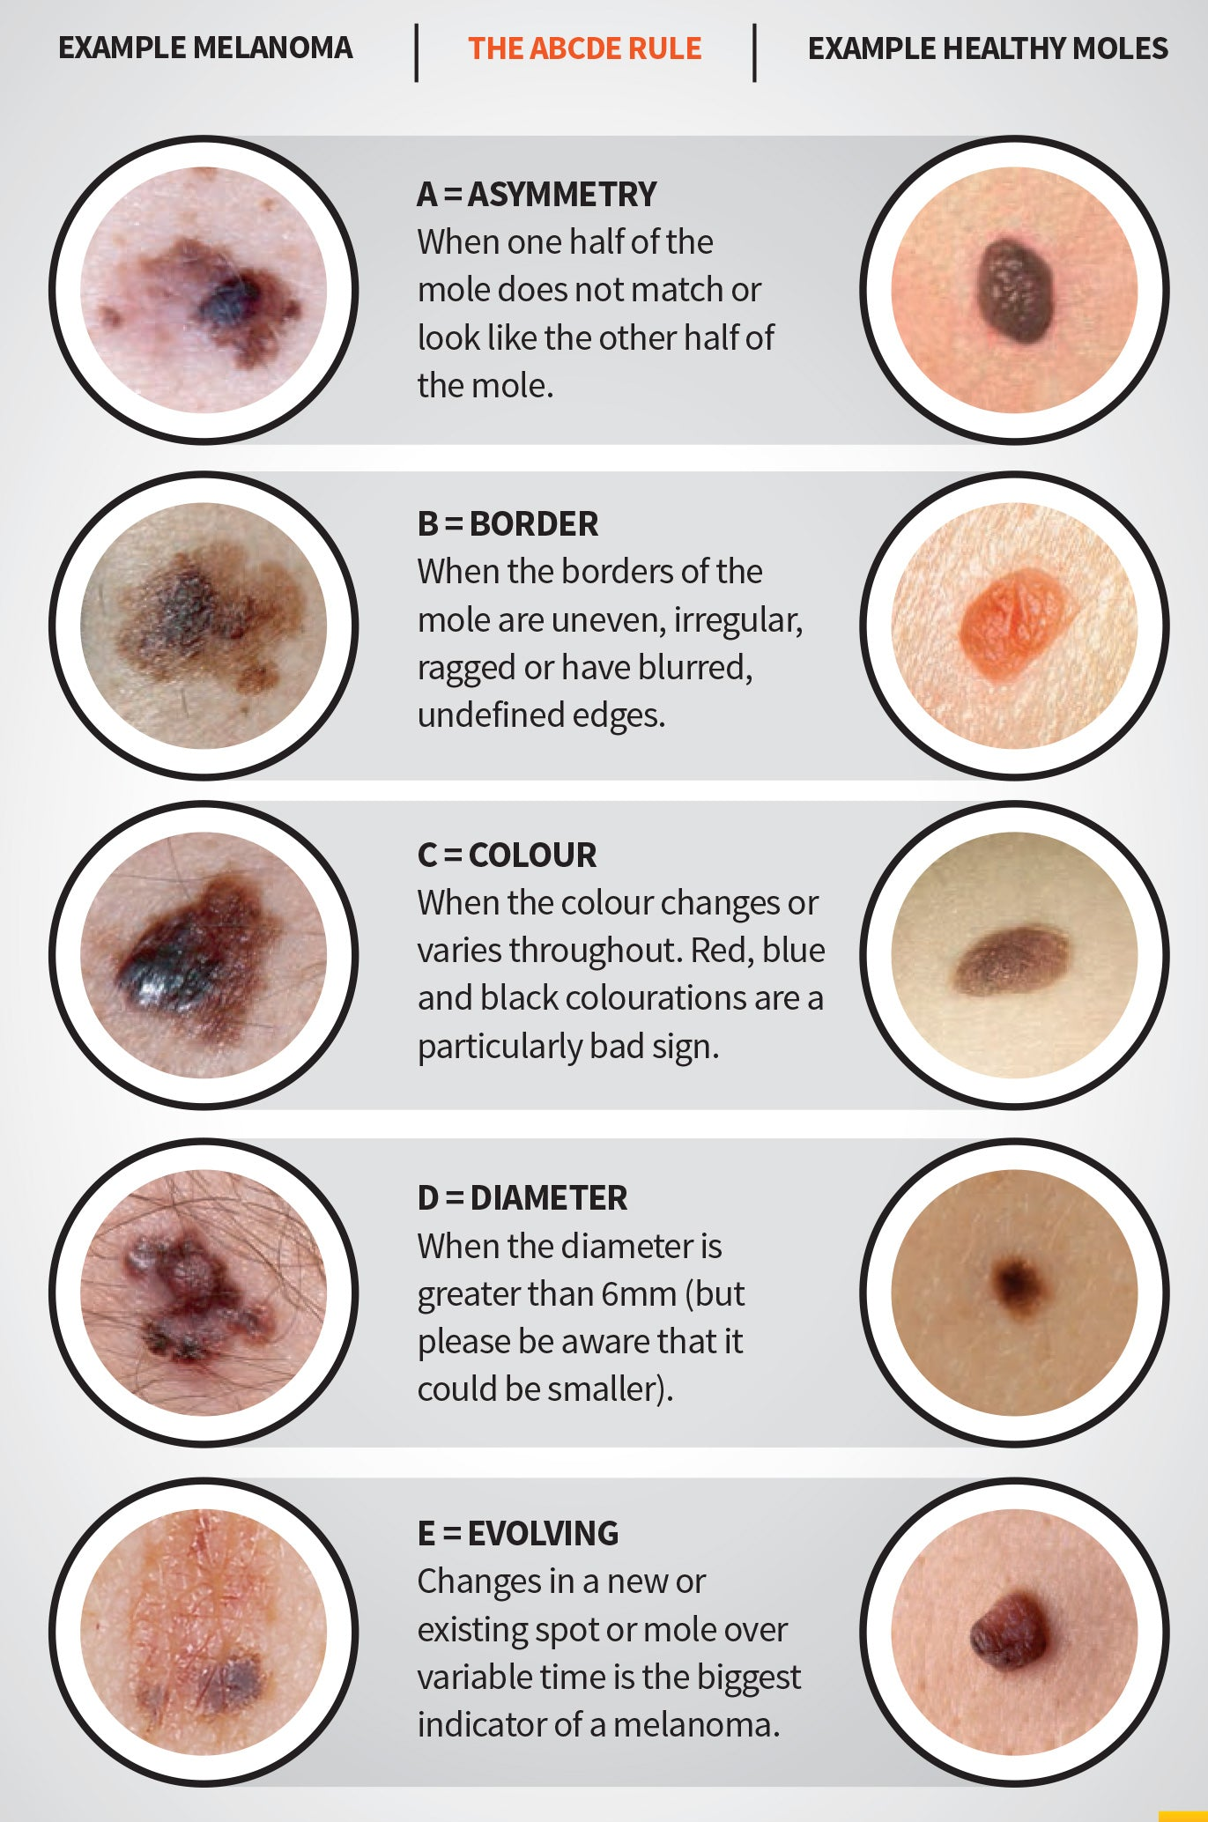
Real-World Applications of Machine Learning
Weather Prediction
Product Recommendation
Skin Cancer

Slide 25
Concepts, Instances, and Attributes in Real-World Problems
Problem
Concept
Instances
Attributes
Skin Cancer Screening
Presence of cancer or
Type of cancer, i.e.
(benign/malignant)
Patient (patient records)
(Skin lesions or skin images)
Texture, shape, color, size, asymmetry, age, gender, family history, UV exposure, biopsy data
Weather Prediction
Temperature or
Amount of rain or
The UV index or
any other weather feature
Temperature, humidity, wind speed, pressure, precipitation, cloud cover, time
Day
Product Recommendation
Interested or not
Customer product pairing
Customer
name, age, address, gender, shopping log, credit card information, loyalty card information
Understanding these four elements is essential for effective machine learning implementation. The problem defines our goal, instances represent our data points, attributes provide the features for pattern identification, and the concept defines the o/p to be predicted.

Slide 26
Machine Learning Models
Problem
Likely ML Approach
Suitable Models
Skin Cancer Screening
Binary Classification
CNNs (for images), Logistic regression, SVM, Random Forests
Weather Prediction
Regression (temperature: 27℃)
Classification (“Sunny”, “Rainy”)
Linear Regression, Random Forests, Logistic Regression
Product Recommendation
Clustering
Association Rule Mining
K-means Clustering

Slide 27
Generalization in Machine Learning
Problem
Generalization Difficulty
Reasoning
Skin Cancer Screening
Difficult
Age biases
Weather Prediction
Easy
Add geographic information (longitude, altitude, distance from ocean)
Product Recommendation
Difficult
Country based holiday purchasing
Generalization is the ultimate goal of machine learning. A model that generalizes well can make accurate predictions on data it hasn't seen before.

Slide 28
Common Assumptions in Machine Learning
1
Concept is actually related to the attributes
Feature Independence
2
Variables don't influence each other. Correlation between features can impact model performance.

Slide 29

What about Fraud Detection?
Instance
Attributes
Concept
Likely ML Approach

Slide 30
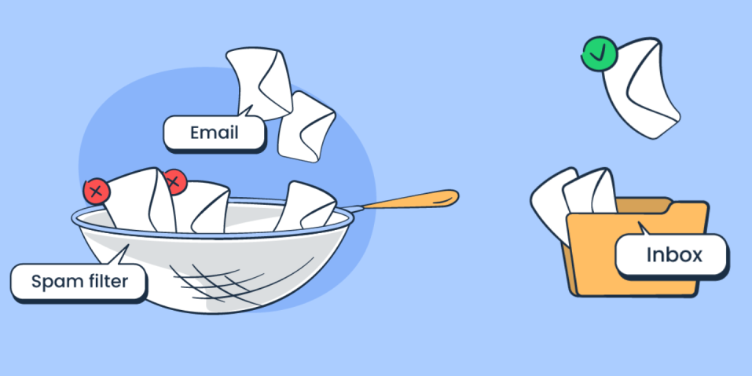
What about Email Spam Filtering?
Instance
Attributes
Concept
Likely ML Approach

Slide 31
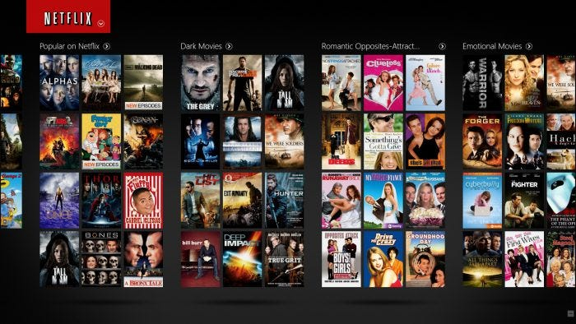
What about Movie Recommendation System?
Instance
Attributes
Concept
Likely ML Approach
https://www.theodysseyonline.com/10-netflix-movies-watch-stressed

Slide 32


Slide 33
ncotugnomorr@student.unimelb.edu.au
jane.xu1@student.unimelb.edu.au
cdavistope@student.unimelb.edu.au
lsanares@student.unimelb.edu.au
shangyic@student.unimelb.edu.au
quytrongduct@student.unimelb.edu.au
bojueh@student.unimelb.edu.au
lkrunic@student.unimelb.edu.au
phanminhquan@student.uninelb.edu.au
peileic@student.unimelb.edu.au
ayuxin@student.unimelb.edu.au
gnnand@student.unimelb.edu.au
qiangeh@student.unimelb.edu.au
lokyiuw1@student.unimelb.edu.au
xuhao1@student.unimelb.edu.au
thihongminhd@student.unimelb.edu.au
liyur@student.unimelb.edu.au
nuij@student.unimelb.edu.au
xinrtang1@student.unimelb.edu.au
suhasa@student.unimelb.edu.au
kpatt@student.unimelb.edu.au
chathenkeril@student.unimelb.edu.au
hongyuel1@student.unimelb.edu.au
fjshen@student.unimelb.edu.au

